Slide 1

Bharati Vidyapeeth Department of Engineering, Navi Mumbai
Chronic Kidney Disease Detection Using Machine Learning

Slide 2
Group Members
(CSBS)
Group Mentor
Ishika Verma Vikas Goyat Sudiksha Ravale
Prof. Sumita Kumar

Slide 3
Abstract
Chronic kidney disease (CKD) is a common and serious health condition that affects millions of people worldwide. Early detection and accurate prediction of CKD can help to prevent further damage to the kidneys and improve patient outcomes.
Chronic Kidney Disease also recognized as Chronic Renal Disease, is an uncharacteristic functioning of kidney or a failure of renal function expanding over a period of months or years.
Several risk factors have been identified as important predictors of CKD, including age, gender, race, diabetes, hypertension, and family history of kidney disease.

Slide 4
Introduction
Chronic kidney disease (CKD) is a condition in which the kidneys are damaged and cannot filter blood properly. The disease can progress over time and lead to serious complications, such as kidney failure, cardiovascular disease, and anemia.
Early detection and treatment of CKD can slow down the progression of the disease and reduce the risk of complications.
Machine learning algorithms can be used to predict the risk of CKD and identify patients who may benefit from early interventions.
Predictive models can use various data sources, such as medical records, laboratory tests, and demographic information, to predict the risk of CKD and estimate the severity of the disease.

Slide 5
Literature Review
"A Machine Learning Framework for Prediction of Chronic Kidney Disease" by Rana et al. (2020): In this study, the authors developed a machine learning framework to predict CKD using clinical data from electronic health records. They used a logistic regression model and a random forest model to predict CKD and achieved an accuracy of 90% and 93%, respectively.
"Prediction of Chronic Kidney Disease Using Machine Learning Algorithms" by Talaat et al. (2020): The authors of this study used a dataset of 400 patients with CKD and 400 healthy controls to develop a predictive model for CKD using decision trees, logistic regression, and support vector machines. They found that the decision tree algorithm had the highest accuracy, sensitivity, and specificity in predicting CKD.

Slide 6
Literature Review
"Prediction of Chronic Kidney Disease Using Ensemble Machine Learning Algorithms" by Gajjala et al. (2021): The authors of this study used a dataset of 1,810 patients with CKD and 4,700 healthy controls to develop a predictive model for CKD using ensemble machine learning algorithms. They found that the XGBoost algorithm had the highest accuracy, sensitivity, and specificity in predicting CKD.
"Predicting Chronic Kidney Disease Progression from Electronic Health Record Data Using Machine Learning" by Wang et al. (2019): The authors of this study used electronic health record data from a large medical center to predict CKD progression using a random forest algorithm. They achieved an accuracy of 75% in predicting CKD progression.

Slide 7
Research Gap
Author Names | Paper Name | Year | Research Gap
Samrat Kumar Dey | "A hybrid feature selection approach for chronic kidney disease prediction" | 2020 | Dataset not properly. They reduce the attributes
Tanvir Ahamad | "An ensemble learning approach for early prediction of chronic kidney disease" | 2020 | Incomplete Evaluation of the prediction model. Researchers need to evaluate the models performance using different metrics and technique
Kailash Kumar. | "A deep learning-based approach for predicting chronic kidney disease using electronic health records" | 2020 | Missing data failure to address the issue of missing data.

Slide 8
Research Gap
Author Names | Paper Name | Year | Research Gap
Jing Xiao. | "A comparison of machine learning algorithms for predicting chronic kidney disease progression" | 2020 | Improved algorithms for predicting CKD progression are needed to overcome these limitations and improve accuracy
Nguyen et al. | "An investigation of feature selection and classification algorithms for CKD prediction" | 2021 | Lack of interpretability of the prediction model, they not provide a clear explanation of how the model works or how the selected predictors are related to CKD prediction.

Slide 9
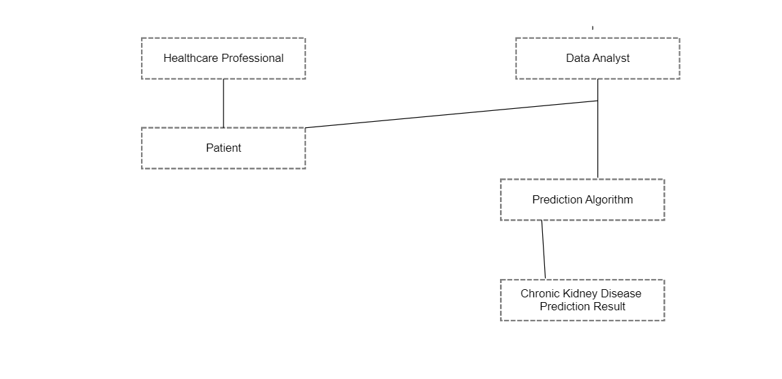
Design Methodology

Slide 10
Objective
Early detection: Early detection of CKD is essential for timely intervention and improved outcomes. Machine learning algorithms can be used to identify patients at risk of developing CKD before the onset of symptoms.
Accurate diagnosis: Machine learning algorithms can assist in the accurate diagnosis of CKD by analyzing patient data, such as laboratory test results, medical history, and imaging studies, to identify patterns and make predictions.
Prediction of disease progression: CKD is a progressive disease that can lead to kidney failure if not managed properly. Machine learning algorithms can be used to predict disease progression and identify patients at risk of developing complications.
Improved outcomes: Early detection, accurate diagnosis, and personalized treatment can ultimately lead to improved outcomes for patients with CKD, including better quality of life and reduced healthcare costs.

Slide 11
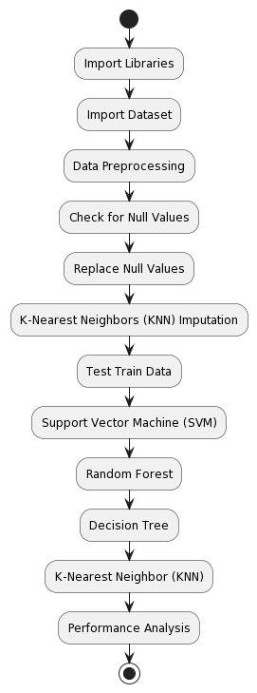
Activity Diagram

Slide 12
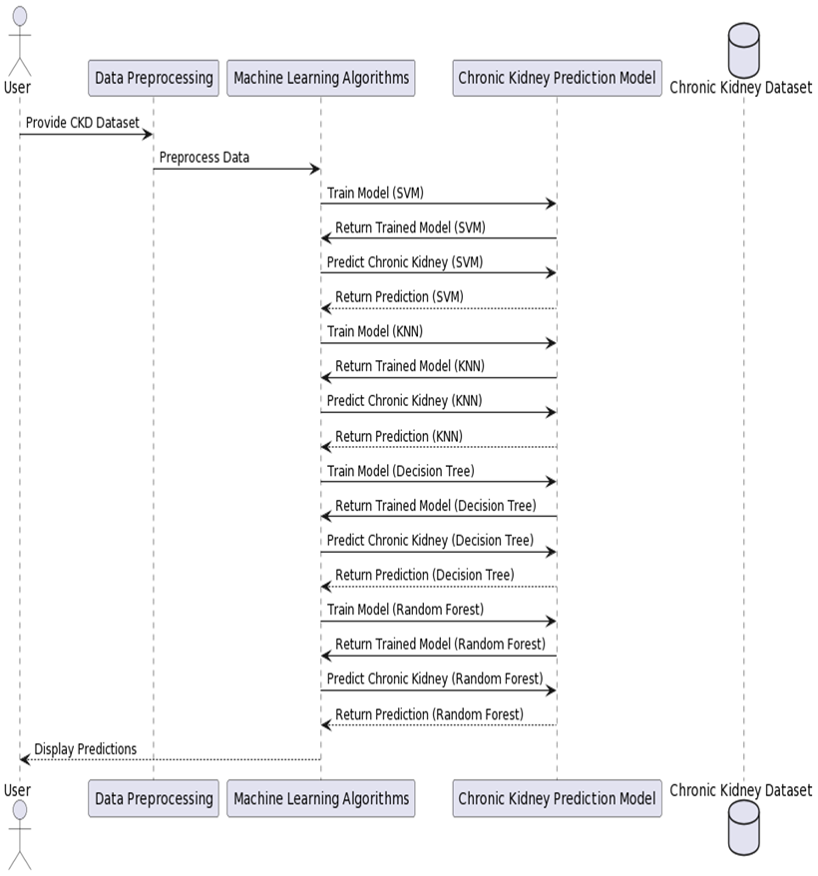
Sequence Diagram

Slide 13
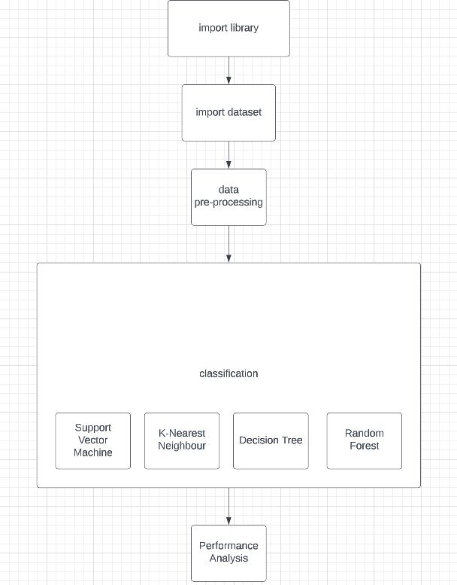
Proposed Methods

Slide 14
Implementation
Preprocess the data: The first step is to preprocess the data to make sure it is clean and ready for use.
Split the data: The next step is to split the data into a training set and a testing set.
Classification: In this we are going to build svm, decision tree, k-nn and random forest.
Evaluate the model: Using the testing set, evaluate the model's performance by comparing the predicted CKD status with the actual CKD status.
Fine-tune the model: If the model's performance is not satisfactory, you may need to fine-tune the model by adjusting the hyperparameters.
Make predictions: Once you are satisfied with the model's performance, you can use it to make predictions on new data.

Slide 15
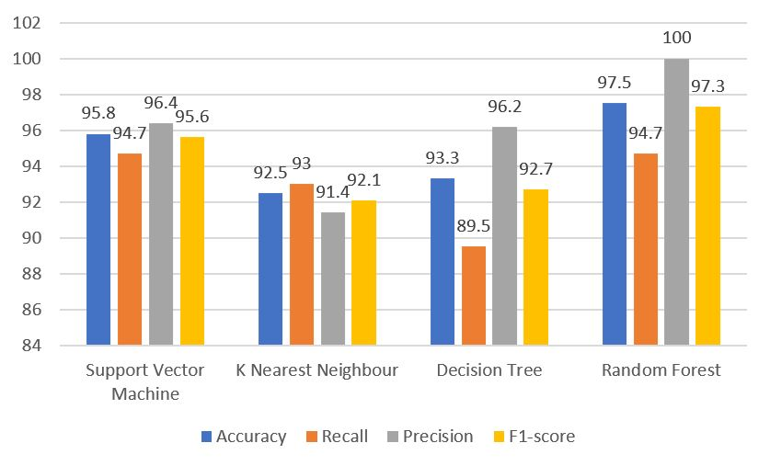
Result

Slide 16
References
Shamima Akter, Ahsan Habib, MD. Ashiqul Islam, MD. Sagar Hossen, Wasik Ahmmed Fahim, Puza Rani Sarkar and Manik Ahmed," Comprehensive Performance Assessment of Deep Learning Models in Early Prediction and Risk Identification of Chronic Kidney Disease” 2021 IEEE 12th International Conference on Application of Information and Communication Technologies (AICT), 2021, doi: 10.1109/ACCESS.2021.312949.
Y. Amirgaliyev, S. Shamiluulu and A. Serek, "Analysis of Chronic Kidney Disease Dataset by Applying Machine Learning Methods," 2018 IEEE 12th International Conference on Application of Information and Communication Technologies (AICT), 2018, pp. 1-4, doi: 10.1109/ICAICT.2018.8747140.
Marwa Almasoud, Tomas E Ward, "Detection of Chronic Kidney Disease using Machine Learning Algorithms with Least Number of Predictors", international Journal of Advanced Computer Science and Applications (IJACSA), Volume 10 Issue 8, 2019, doi:10.14569/IJACSA.2019.0100813.
Linta Antony, Sami Azam, Eva Ignatious, Ryana Quadir, Abhijith Reddy Beeravolu, Mirjam Jonkman and Friso De Boer, “A Comprehensive Unsupervised Framework for Chronic Kidney Disease Prediction”, 2020 11th International Conference on Computing, Communication and Networking Technologies (ICCCNT), doi: 10.1109/ICCCNT49239.2020.9225548.
Bilal Khan, Rashid Naseem, Fazal Muhammad, Ghulam Abbas, Sunghwan Kim,” An Empirical Evaluation of Machine Learning Techniques for Chronic Kidney Disease Prophecy”, doi: 10.1109/ACCESS.2020.2981689.
S.Revathy, B.Bharathi, P.Jeyanthi, M.Ramesh, “ Chronic Kidney Disease Prediction using Machine Learning Models “, International Journal of Engineering and Advanced Technology (IJEAT), doi: 10.35940/ijeat.A2213.109119.
Gunarathne W.H.S.D,Perera K.D.M, Kahandawaarachchi K.A.D.C.P , “ Performance Evaluation on Machine Learning Classification Techniques for Disease Classification and Forecasting through Data Analytics for Chronic Kidney Disease (CKD) ”, 2017 IEEE 17th International Conference on Bioinformatics and Bioengineering.

Slide 17
ThankYou

